Slide 1
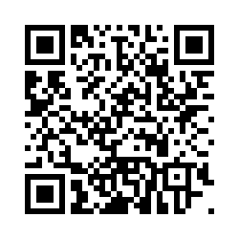
Have you done a pre-lesson knowledge check in?
Notes:
The student pre-lesson knowledge check in is optional.
There is a QR code and link document that you can display if children have access to smart devices.
It is an online survey. The children will be asked to come up with a unique code that they will use again for the post lesson survey. They can write it down. The same prompt questions will be used after the lessons to help them remember. (There is a risk that students spend ages deciding their favourite TV show to help them come up with a code. Encourage them to make a quick decision, ideally different from each other!).
These are the questions they will be asked:
Introduction:
Hi. Before we get started on the lessons, let’s find out what you already know about young children and their brains.
We are going to ask you a number of questions. Select whichever answers you think are correct. Don't worry, we do not know who is answering the questions. If you don’t know the answer, that’s okay, just choose the 'I don't know' option.
Thanks for taking part!
Student ID:
To create an anonymous and unique student ID, we are going to ask you 3 questions. Your answers will make your student ID.
Q1. What are the initials of your full name?
For example, John James Smith would write JJS. Arjun Patel would write AP.
Q2. What are the first 3 letters of your favourite TV show/series?
If the title begins with 'The', please use the next word.
For example, The Simpsons, you would write 'Sim' and Doctor Who, would be 'Doc'.
Q.3 What is your house number or name?
For example, if you live at 10 Downing Street, you would write 10.
Or if you live at Holly House, you would write Holly House.
If you have moved house since doing the first quiz, please use the house number or name of where you used to live.
Your Student ID is: XXX
Demographic Questions:
Q1. What school do you go to?
Q2. What year group are you in?
Year 3
Year 4
Year 5
Year 6
Multiple Choice Questions
Q1. What is the role of the brain? (Tick any that are correct)
a) to form and store memories
b) to control the movement of your legs
c) to control breathing
d) to help you think and learn
e) I don’t know
Q2. What is the brain made of? (Choose one answer)
a) muscle cells
b) neurons
c) bone
d) jelly
e) I don’t know
Q3. Which of the following best describes brain development (or growth) in the first 5 years of life? (Tick any that are correct)
a) the brain grows very fast
b) the brain’s structure is determined by the experiences a child has.
c) the brain is fully grown at birth
d) a child’s caregiver plays an important role in brain growth
e) I don’t know
Q4. Which of the following will help a baby’s brain grow healthily? (Tick any that apply)
a) eating nutritious food
b) a parent or carer reading a book
c) a carer singing to the baby
d) growing up in a safe and caring home
e) playing peekaboo
f) I don’t know
Q5. Which of the following best describes why early brain development (or growth) is important? (Tick any that apply)
a) it helps a child learn and do better at school
b) it forms a strong base for lifelong health and wellbeing
c) it doesn’t matter – the brain grows throughout life
d) because this is when all memories form
e) I don’t know
End of survey:
Thank you, you have now completed this quiz!
We hope you enjoy taking part in the lessons!

Slide 2
Let us know you are starting to teach the SEEN lessons! https://seen.qualtrics.com/jfe/form/SV_6gk6TEYny4KylPU
Notes:
Please complete this 1 minute survey. It will just ask you for school name, year group, teacher name and number of pupils.
It tells us you are teaching the lessons!

Slide 3
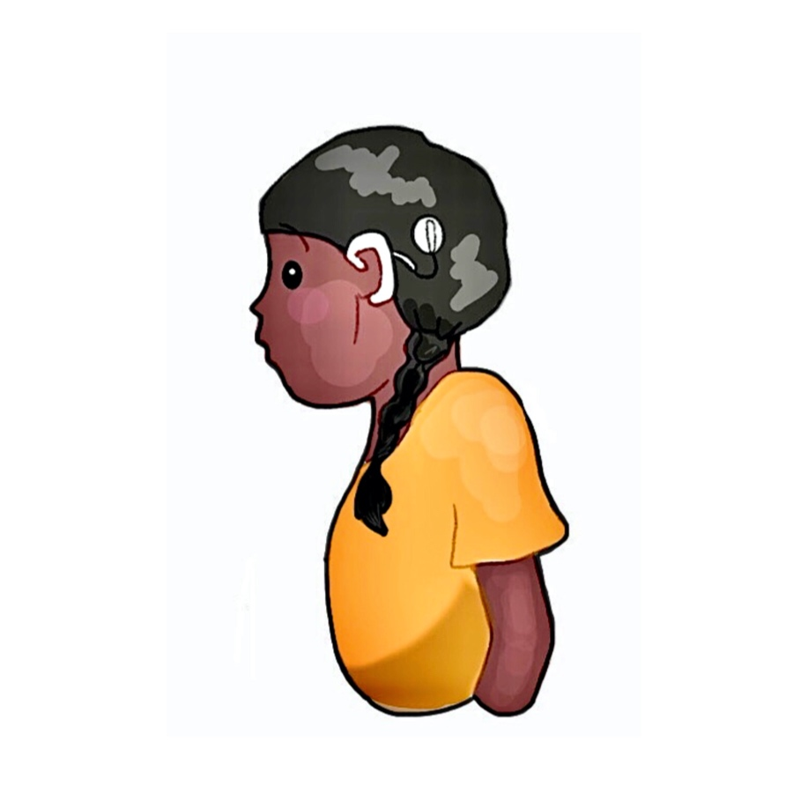
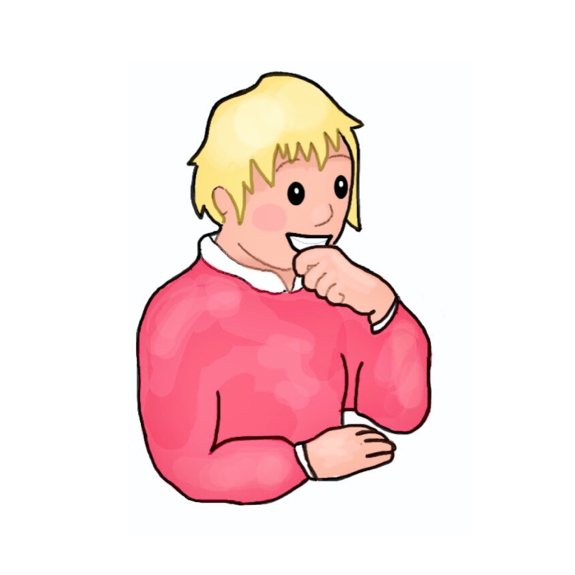
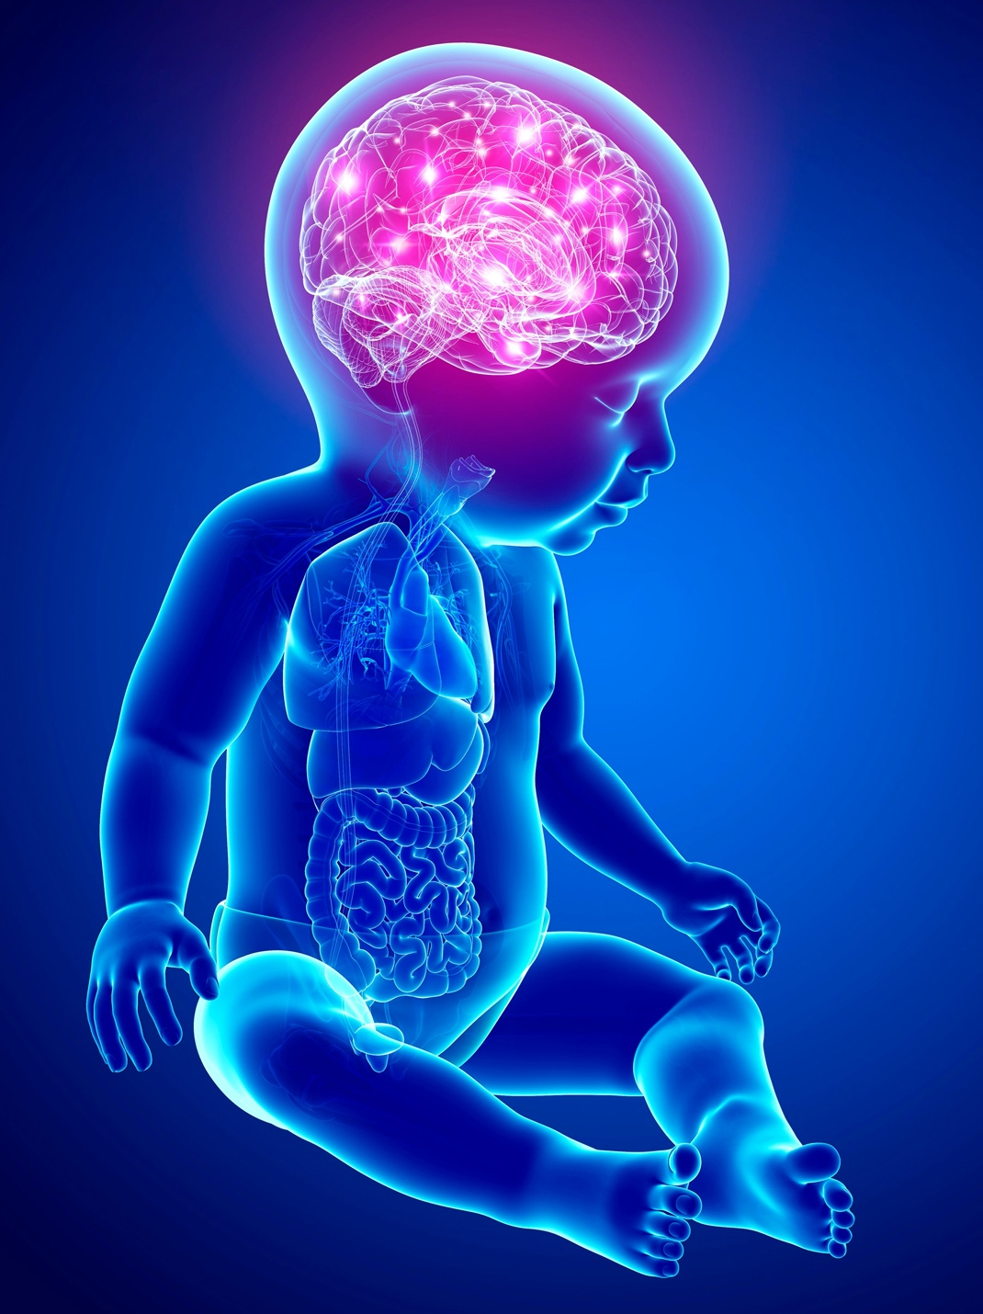
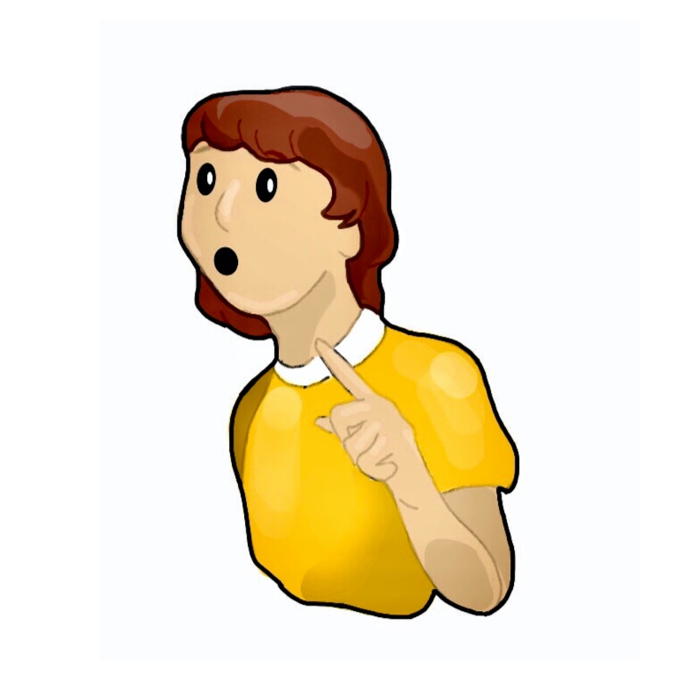
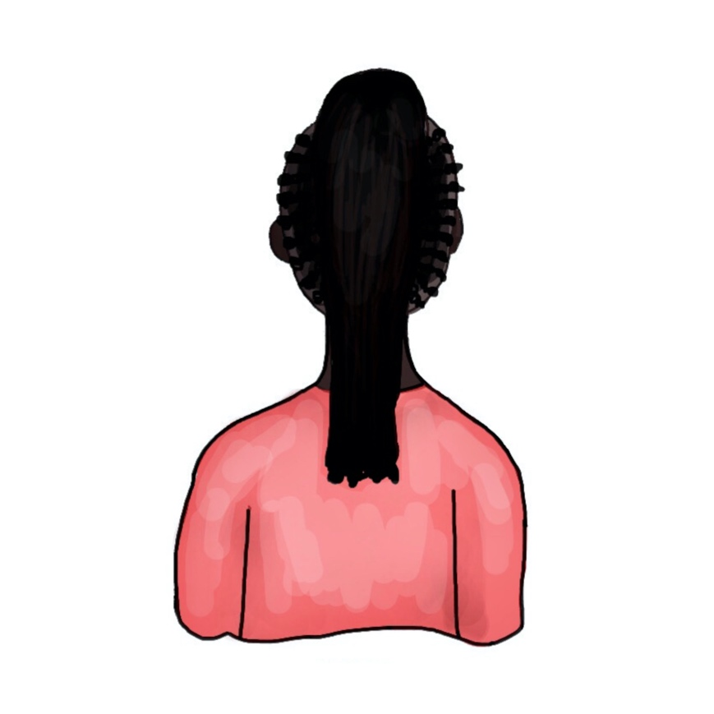
The brain is…
The brain is made of neurons and fully formed at the end of childhood.
Evie
The brain is made of neurons. They connect to form pathways through the brain.
The brain is a muscle. The more you practise, the stronger it gets.
Ben
The brain is like a computer with hard-wired electrical circuits.
?
Pat
Lilly
Tam
Notes:
Tell the class
Young people have been asked to explain what the brain is. Read their answers. Who do you agree with and why?
Ben - The brain is made of neurons. They connect to form pathways through the brain.
This is correct. The brain is made of neurons (although also blood vessels and some other nerve cells called glial cells). Neurons are interconnected to form pathways or circuits in the brain. Experiences determine which pathways form. The brain is plastic and its structure can change in response to experiences.
Evie - The brain is made of neurons and fully formed at the end of childhood.
The brain is made of neurons, but it can change throughout life. The first few years of childhood the brain grows and changes considerably… and again in adolescence. It is fully “mature” by the end of adolescence – some time in the mid twenties (depending on the individual) - but it can change in response to experiences throughout life.
Pat - The brain is a muscle. If you practise the brain gets stronger.
This is a common misconception, that the brain is a muscle, or made of muscle cells. It is not a muscle, it is made up of nervous and circulatory tissue.
It is the case that the more you repeat an activity the stronger a ‘pathway’ becomes… and therefore the more likely a message will pass along a neural pathway.
Lilly - The brain is like a computer with hard-wired electrical circuits.
The brain is often compared to a computer as it is organized with certain bits specialized for certain tasks, connected along pathways (like wires) and communication takes place in part through ions (pulses of electricity). However, it is not ‘hardwired’ or determined… it is plastic. For instance rewiring can happen when a new skill is learnt; or parts of the brain can compensate for lost tissue after a brain injury.
Tam – doesn’t know… or is the one trying to decide what they think!

Slide 4
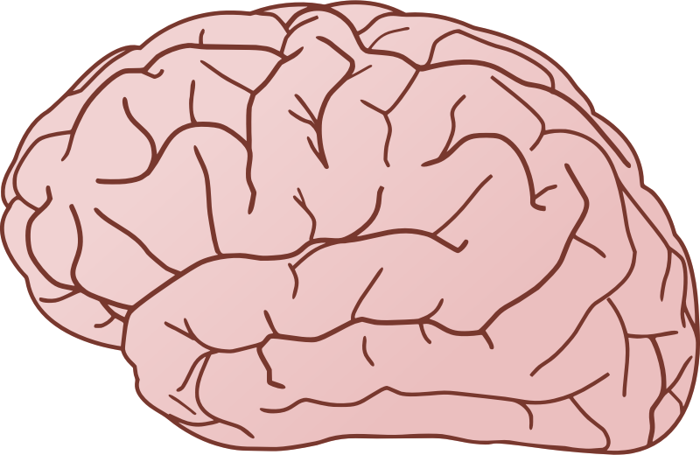
The human brain
Notes:
What do you already know about the brain?
Stop, think, pair, and share.
Listen to the children’s ideas.
Or:
Draw the brain –
Represent in your drawing:
- what you understand about the brain e.g. what it does or what it is made of, what it looks and feels like etc.
This activity could be extended to a whole lesson, with a class discussion after the art-work part to challenge misconceptions.

Slide 5
The brain

Slide 6
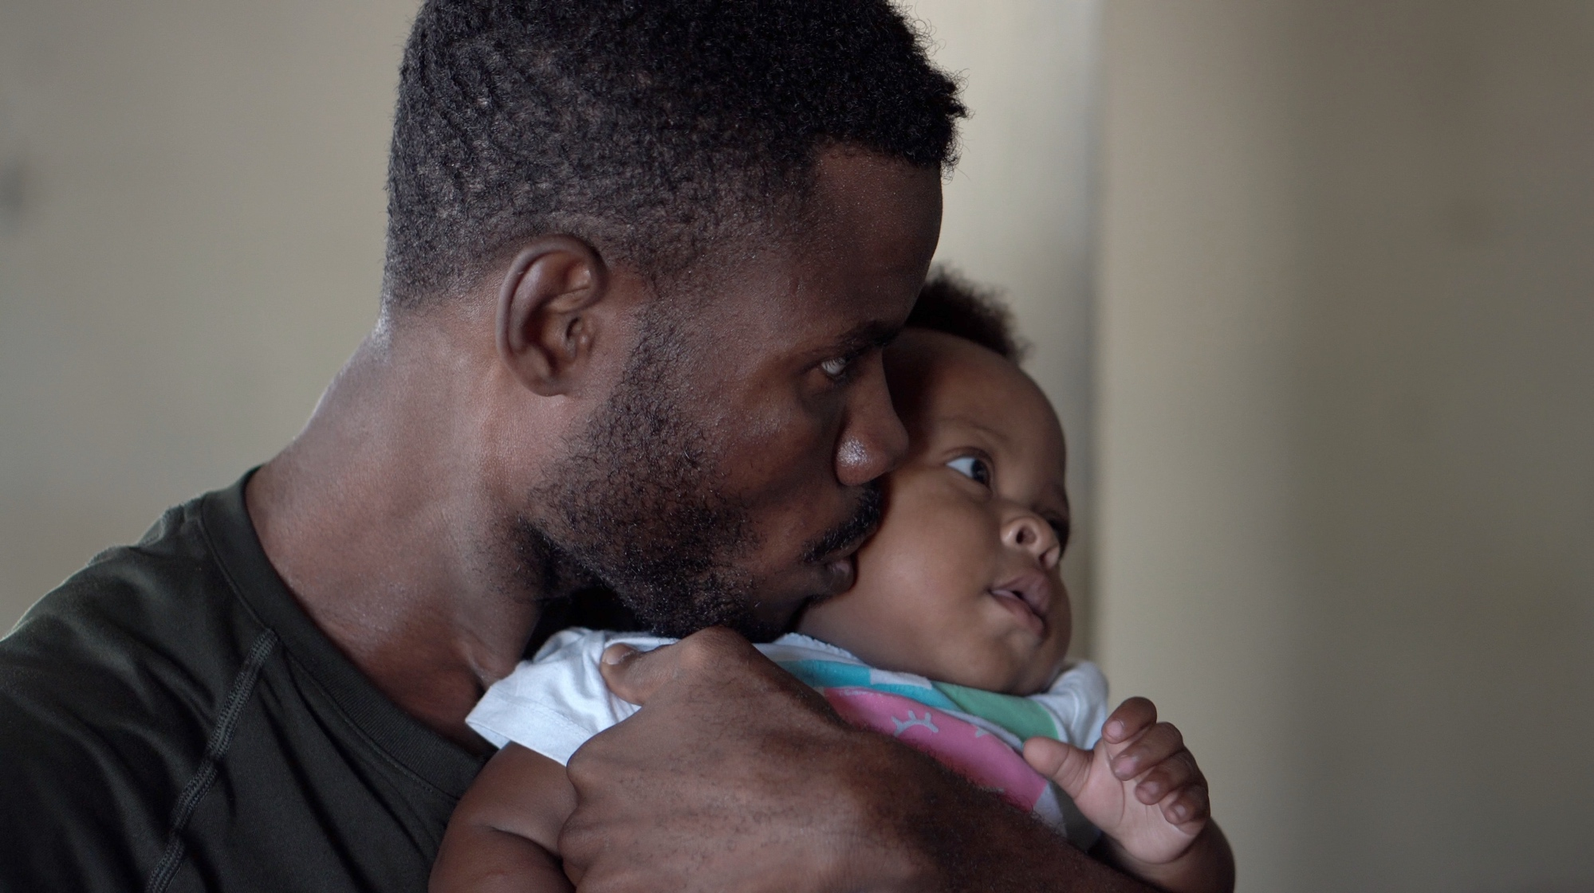
Learning objectives
Describe the structure of the brain and what it does
Explain that the brain is a network of pathways
Pathways are strengthened and weakened by experiences

Slide 7
The brain…
… is protected by your skull.
… is an organ of your body made of soft tissue (nerve cells).
… controls your body:
thoughts and memories
movement
internal processes e.g. breathing
Notes:
Optional consolidation slide
http://www.educationalneuroscience.org.uk/resources/neuromyth-or-neurofact/
Is a great resource for checking what we do, and don’t know about the brain.
Addressing misconceptions:
- The brain is not a muscle or made of muscle.
- people are not ‘right’ or ‘left’ brained people, (nor any associated characteristics, learning, subject preferences).
- there is little evidence to support the idea that pupils have specific learning styles.
- It is a myth that we only use 10% of our brain – We use all of the brain, all of the time (although not all neurons are firing all the time).
The brain is:
- Contained within the skull for protection
- Is made of soft tissue consisting of nerve cells (neurons) some other support cells and small blood vessels.
- malleable – it’s structure is influenced by an individuals experiences, a concept called neuroplasticity.
Sleep is important for memory and learning.

Slide 8
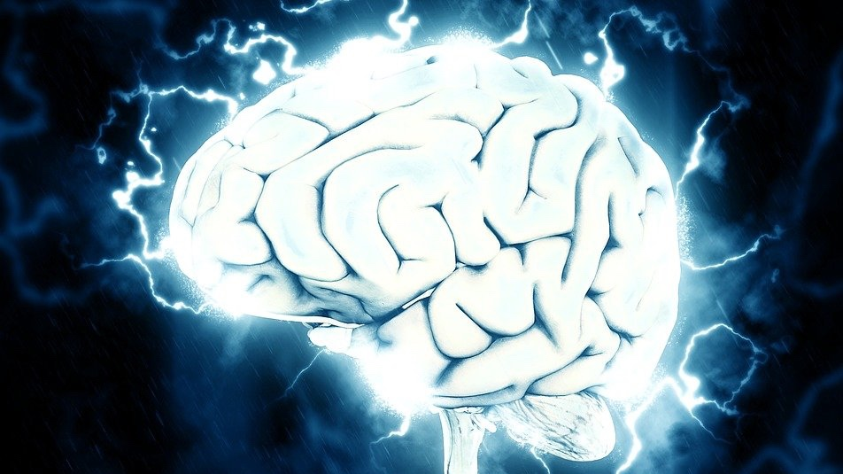
Let’s make a brain!

Slide 9
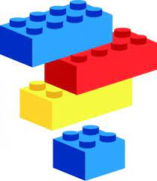
What are the building blocks of the brain?
What is the brain made of?
Notes:
If you have already talked about cells as the building blocks of all living things, you can cross-reference that learning.

Slide 10
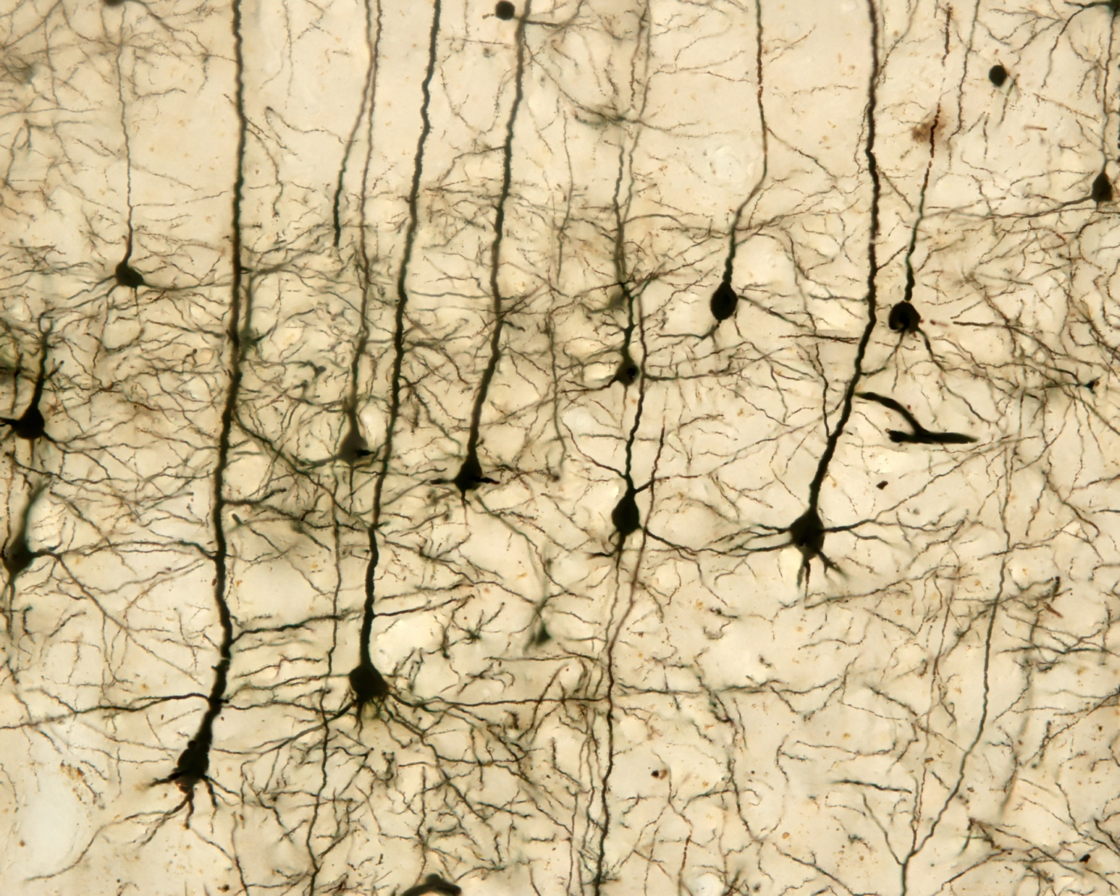
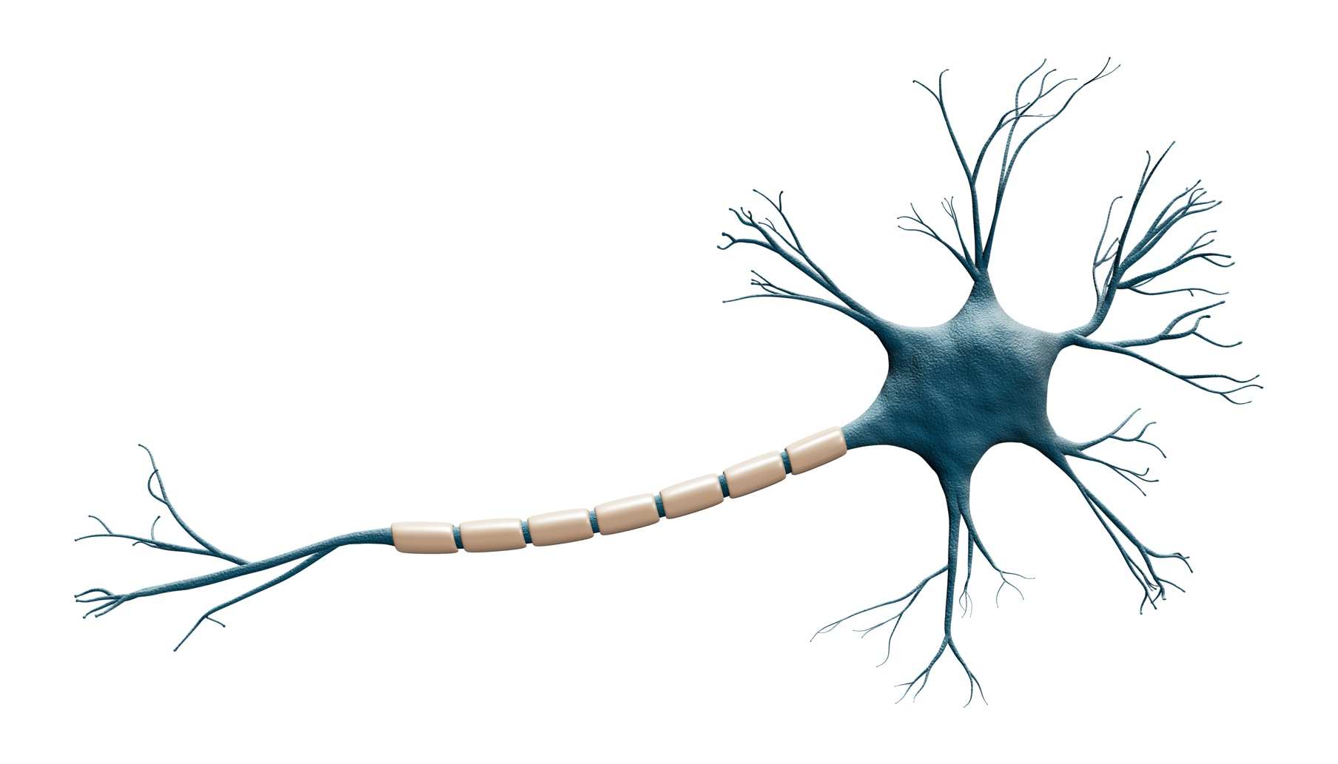
The cells that make up the brain are called neurons
A drawing of a typical neuron
Many neurons viewed using a microscope
Notes:
Note that a dye will have been used to make the neurons stand out under a microscope.
Some children might have seen the Cbeebies programme Nina and the neurons – you could link this learning to that prior knowledge (https://www.bbc.co.uk/cbeebies/shows/nina-and-the-neurons)

Slide 11
Which words would you use to describe a neuron?
Think… pair… and share
Notes:
Note that a dye will have been used to make the neurons stand out under a microscope.
Encourage the children to suggest words that describe their shape and will help then in their model design e.g. long, thin, spindly,
Alternative, depending on the resources you have in the classroom and the skills of your students:
- research a neuron on the internet (what does it look like, do, etc).

Slide 12
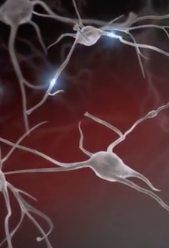
Build a model neuron activity
Notes:
Activity – see also on separate sheet.

Slide 13
Build a model neuron activity
Notes:
Activity – see also on separate sheet.
This slide contains a labelled neuron – stretch and challenge.
Note: the myelin sheath is not present on all neurons. It is a fatty substance that consists of a cell wrapped around the axon of the neuron (a bit like a roly poly with the axon through the middle). It increases the efficiency of the neuron – it helps it to do its job of passing messages through the body (including the brain!)

Slide 14
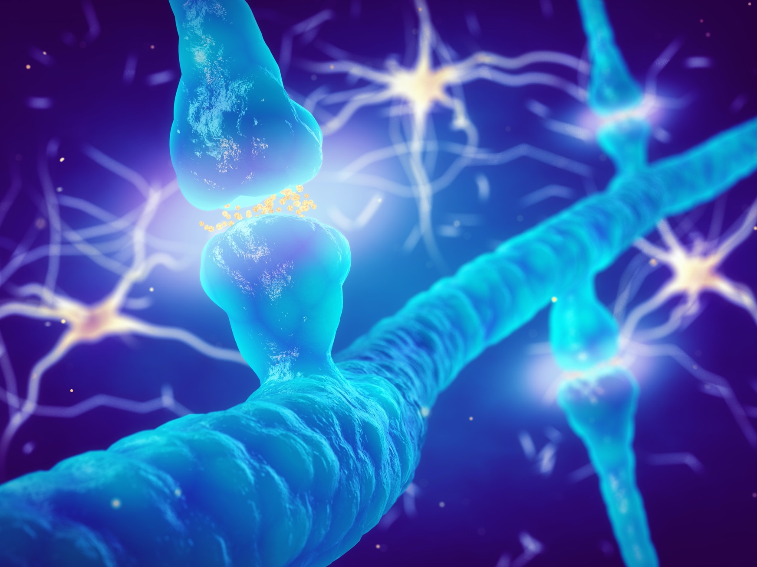
The brain is a network of neurons
Neurons join together to make pathways
Notes:
Once all the class have made their neurons:
Explain that neurons join together to make pathways. This can be demonstrated by using 2 or 3 of the children’s models and lying them end to end. The neurons join between the axon endings of one cell and the finger like extensions (dendrites) of the next cell.
Explain that their brain is made up of about 85 billion neurons.
Arrange all the class models into a circle (could be brain shaped), in many different lines or pathways.
Explain that “We have made a model of the brain – lots of neurons in pathways that form a network”
Although the actual brain have billions more neurons!
The final part is to explain the importance of experiences….
The more we use a pathway the stronger it gets. So the more we practice something e.g. a musical instrument, the better we get at it… because those pathways in the brain become stronger (a bit like a motorway rather than a pathway in the brain!).
This is the same for thoughts, behaviours, skills, learning, emotions and so on.

Slide 15
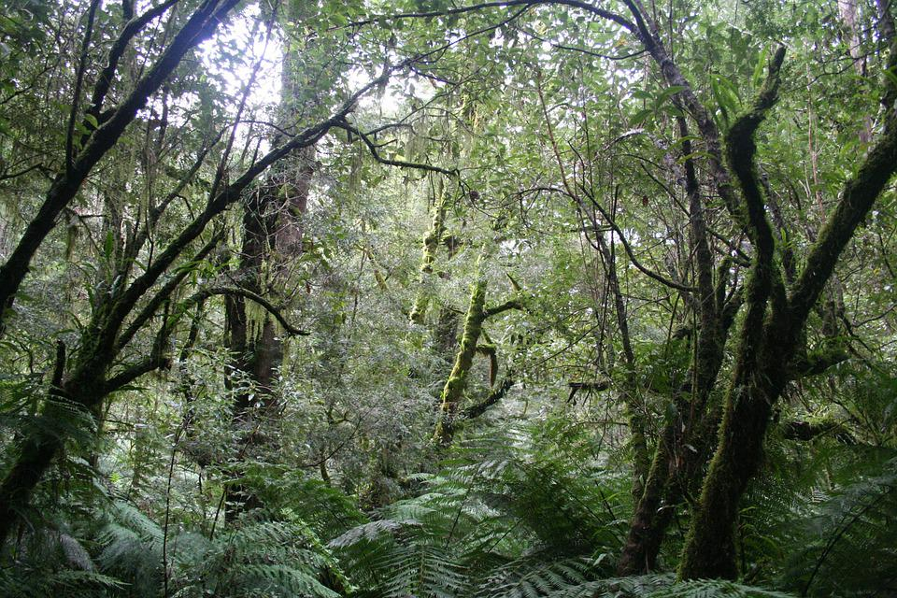
The more you use a pathway the stronger it gets.
Experiences strengthen a pathway in the brain.
Notes:
Experiences include what we see, hear and do, how we behave, how we feel and think, activities we do, and so on.
A helpful analogy is of a jungle – the first time we do something (the first time a connection is made between neurons) it is difficult to make your way and pass through the jungle (the connections are weak). The more you travel the same route… the easier it gets and a path forms through the jungle. The more you do something, the stronger the connections between neurons of that pathway and a message passes easily.
The reverse is also true – the less a pathway is used, the weaker it becomes (if you don’t use a path through a forest, it will regrow and return to thick jungle).
This principle of neuroplasticity can be linked to learning – repetition and persistence strengthens neural connections. Experiences can change the structure of the brain.

Slide 16
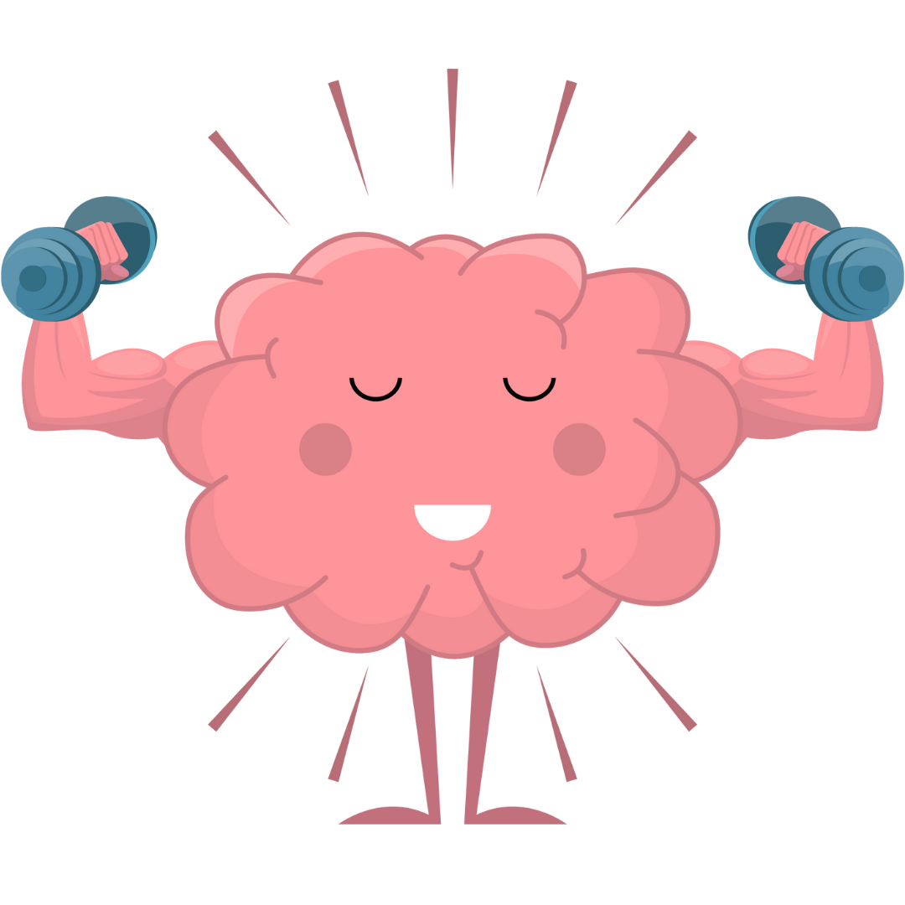
The brain is plastic…
Notes:
The brain is plastic – it changes its structure based on experiences (our relationships, learning, friends, school, home, activities…)
Probably a bit young for the upper KS2 audience, but if you have used the book “Your fantastic elastic brain” before, you can refer to it here.
Or use a piece of playdough or plasticene, make a blob or shape like the brain and ask students what experiences they have… as they list them, change the shape a bit (pull into a sausage, square, bumpy etc – as long as you explain this is a model to help them understand. In the brain it is some pathways strengthen, and some weaken… the neurons might grow, or reduce in size).
https://www.amazon.co.uk/Fantastic-Elastic-Brain-Stretch-Shape/dp/0982993803/ref=asc_df_0982993803/?tag=googshopuk-21&linkCode=df0&hvadid=310783995501&hvpos=&hvnetw=g&hvrand=5395470932876024447&hvpone=&hvptwo=&hvqmt=&hvdev=c&hvdvcmdl=&hvlocint=&hvlocphy=1007190&hvtargid=pla-320157233458&psc=1&th=1&psc=1

Slide 17
Neuroplasticity
https://www.youtube.com/watch?v=ELpfYCZa87g
Notes:
Optional video from the Key Stage 3 resources but can also be used with key stage 2 – illustrates the relationship between pathways and experiences.
Notes from Key Stage 3 lessons:
This video describes briefly (about 2 minutes) what neuroplasticity is. Stress with students that whilst genes play an important role in brain development, it is experiences that shape which connections are made between neurons. The brain is a very good example of genes v environment interactions.
Plasticity occurs throughout life, but there are 2 particularly sensitive periods (0-5 and 11-25 years).

Slide 18
Experiences and the caregiver

Slide 19
Learning objectives
Give examples of ‘caregivers’ for young children
Name 5 ways of growing healthy brains.
Give specific examples of what caregivers can do to grow healthy brains.
Explain why the first years of life are so important.
Reflect on what you can do to grow a healthy brain in a child you know.

Slide 20
The brain is…
The brain is made of neurons and fully formed at the end of childhood.
Evie
The brain is made of neurons. They connect to form pathways through the brain.
The brain is a muscle. The more you practise, the stronger it gets.
Ben
The brain is like a computer with hard-wired electrical circuits.
?
Pat
Lilly
Tam
Notes:
Tell the class
Young people have been asked to explain what the brain is. Read their answers. Who do you agree with and why?
Ben - The brain is made of neurons. They connect to form pathways through the brain.
This is correct. The brain is made of neurons (although also blood vessels and some other nerve cells called glial cells). Neurons are interconnected to form pathways or circuits in the brain. Experiences determine which pathways form. The brain is plastic and its structure can change in response to experiences.
Evie - The brain is made of neurons and fully formed at the end of childhood.
The brain is made of neurons, but it can change throughout life. The first few years of childhood the brain grows and changes considerably… and again in adolescence. It is fully “mature” by the end of adolescence – some time in the mid twenties (depending on the individual) - but it can change in response to experiences throughout life.
Pat - The brain is a muscle. If you practise the brain gets stronger.
This is a common misconception, that the brain is a muscle, or made of muscle cells. It is not a muscle, it is made up of nervous and circulatory tissue.
It is the case that the more you repeat an activity the stronger a ‘pathway’ becomes… and therefore the more likely a message will pass along a neural pathway.
Lilly - The brain is like a computer with hard-wired electrical circuits.
The brain is often compared to a computer as it is organized with certain bits specialized for certain tasks, connected along pathways (like wires) and communication takes place in part through ions (pulses of electricity). However, it is not ‘hardwired’ or determined… it is plastic. For instance rewiring can happen when a new skill is learnt; or parts of the brain can compensate for lost tissue after a brain injury.
Tam – doesn’t know… or is the one trying to decide what they think!

Slide 21
What is the brain?
Notes:
Review learning from the previous session – listen to their ideas.

Slide 22
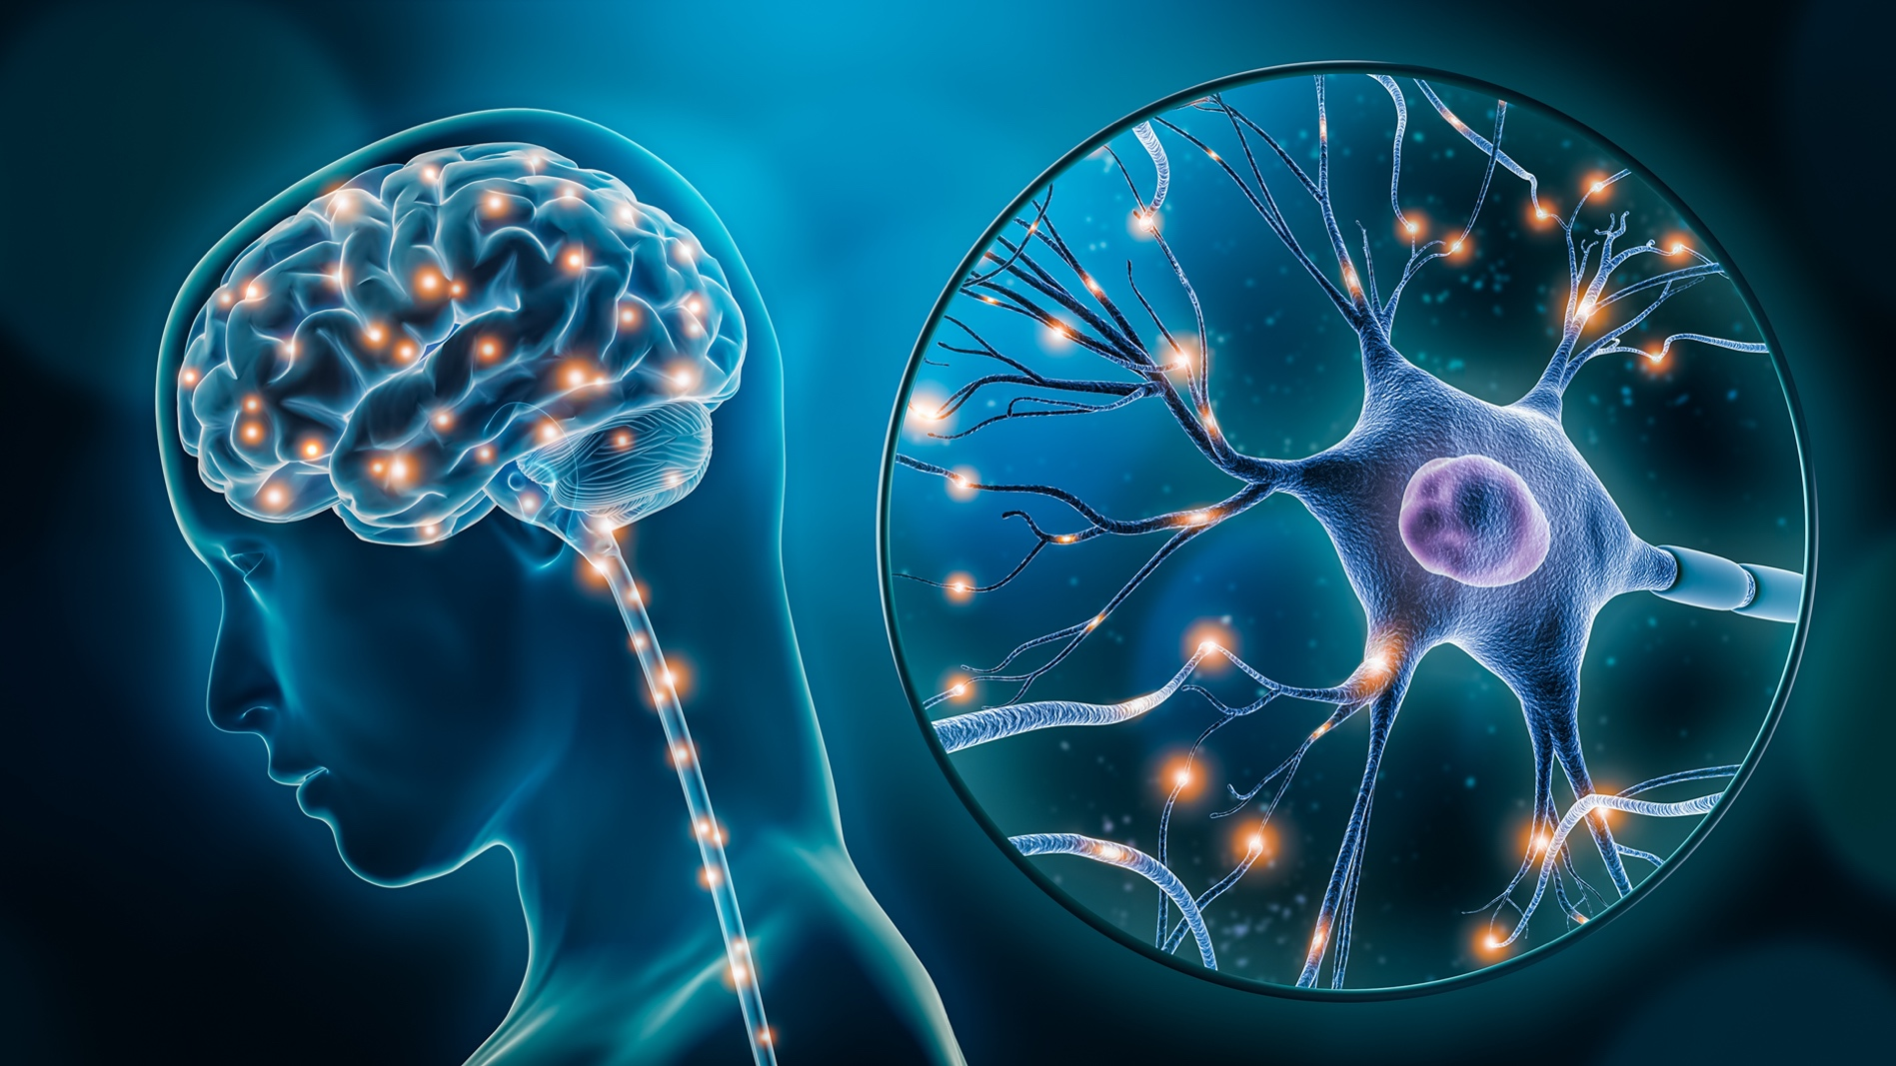
The brain
Controls the body
Is made mostly of neurons
Neurons connect to make pathways
The brain is a big network
Experiences strengthen and weaken pathways
The brain is plastic!
Notes:
The brain is made up of about 100 billion neurons.
Neurons connect to make pathways through the brain.
The brain is therefore a big network of connected neurons / pathways.
Experiences strengthen and weaken pathways through the brain.

Slide 23
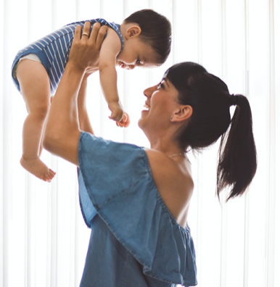
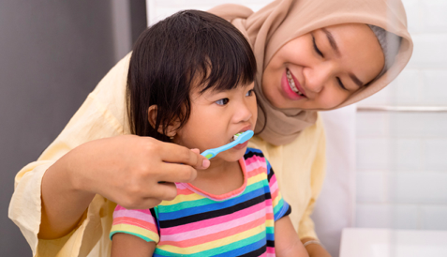
The brain grows fastest in the first years of life.
Experiences during this time are provided by the ‘caregiver’.
Notes:
The brain grows fastest in the first years of life
Experiences from pregnancy to about 5 years, are very important for growing a healthy brain!
Experiences during this time

Slide 24
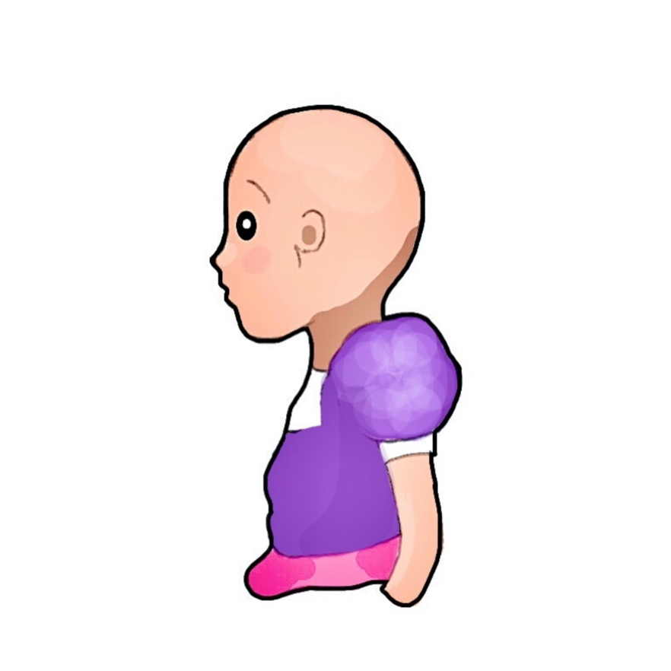
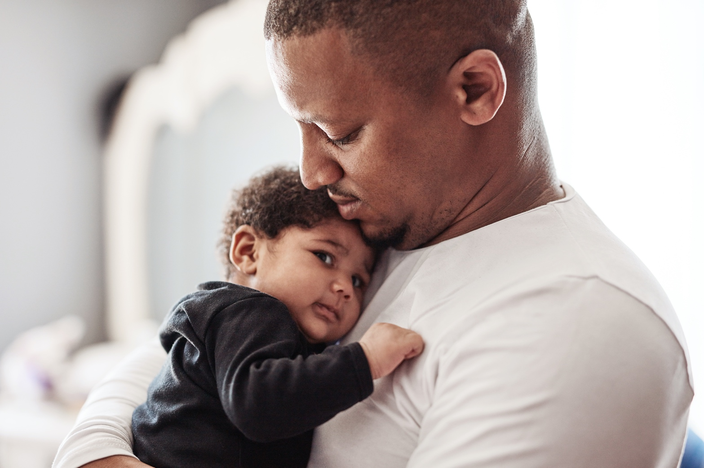
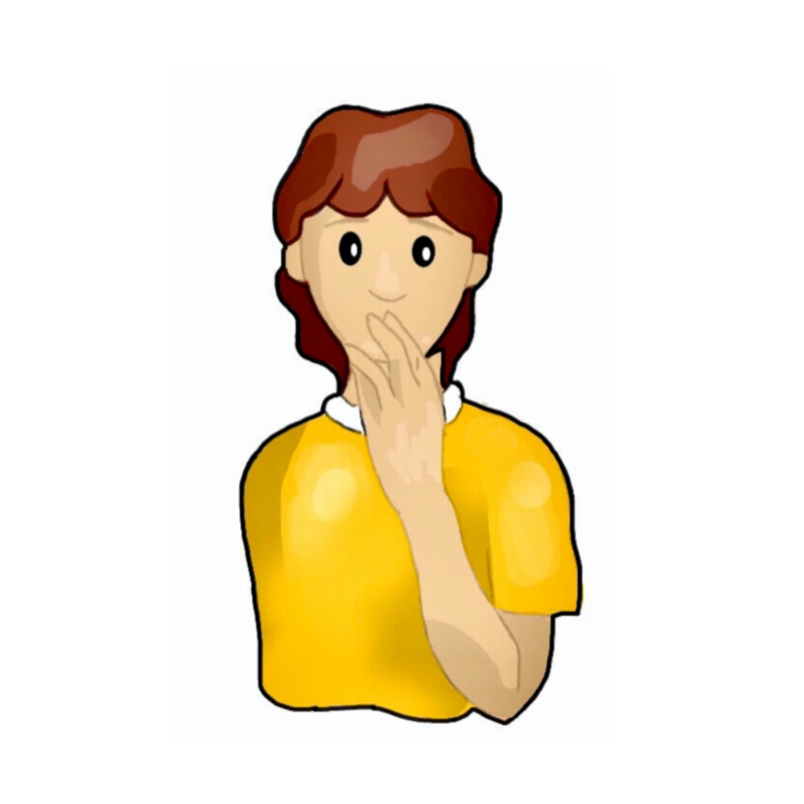
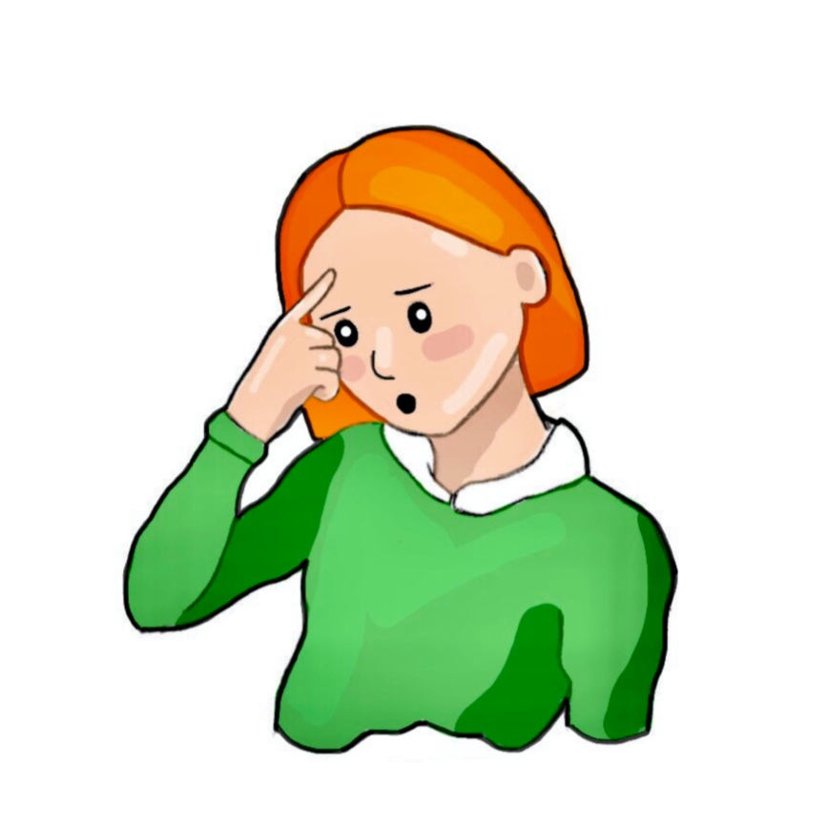
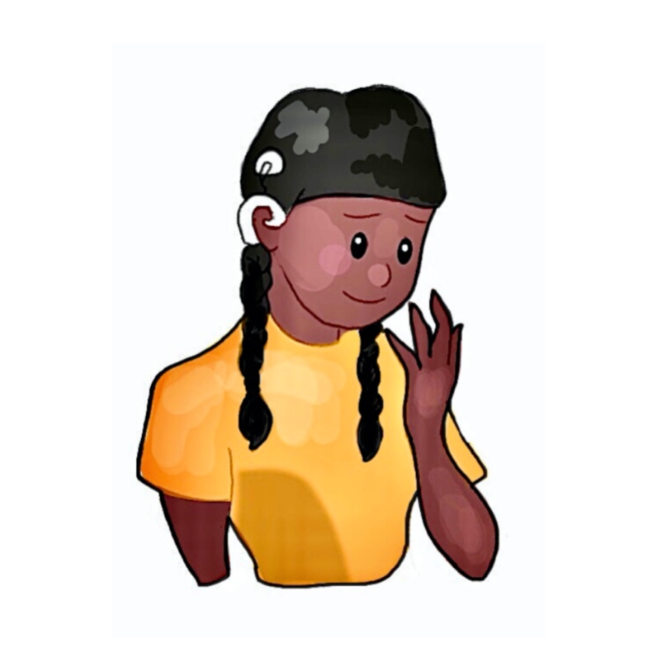
A caregiver ‘shapes’ the brain of a baby and young child…
A caregiver tends to the needs of a child and can include close and extended family members, childminders, nursery practitioners.
When we talk about ‘caregivers’ we are talking about the child’s parents.
Millie
Tyrell
Everybody is a ‘caregiver’ for a child. That’s why there is a saying “it takes a village to raise a child”.
A caregiver is somebody who cares for somebody when they are sick.
?
Pat
Evie
Teigan
Notes:
Tyrell is the closest to the definition we use in these lessons, but also celebrate those that choose Pat – society can play a role collectively for the upbringing of the next generation, after all, they will be impacted more broadly by a prospering and healthy society (early childhood experiences are a predictor of long term health, wellbeing, learning and earnings potential).
People often point to parents as the ones responsible for being the caregiver… but for many families, a family member (e.g. grandparent), childminder or nursery practitioner will be spending lots of time with a baby or child and will therefore have substantial influence on the development of the child’s brain through their interactions. So Millie gives an opportunity to address this issue.
Evie touches on another application of the term caregiver, and it might be worth talking about the broader contest of ‘carers’ – they aren’t always caring for ‘sick’ people! However, in this context Tyrell (or Pat) are closest.

Slide 25
A caregiver ‘shapes’ the brain of a baby and young child… What is a caregiver?
Think, pair and share.
Notes:
Encourage the children to think about who a caregiver is. There first answer might simply be mum or dad… but encourage them to think who else decides what experiences a child has.
There are ideas on the next slide.

Slide 26
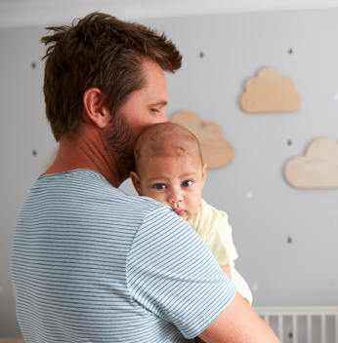
A caregiver tends to the needs of another
For babies and young children:
parents
grandparents
siblings
childminders
nursery professionals
family friend
babysitter
Notes:
The examples here are for

Slide 27
Watch: Experiences build brain architecture https://www.youtube.com/watch?v=VNNsN9IJkws
Notes:
Optional video used in the Key Stage 3 lessons.
This video is 1.57 minutes long. It uses animation to show the connection between neurons and the importance of experiences in shaping which circuits are strengthened.

Slide 28
Hands up if...
You have a sibling that is aged 0-5 years
You have regular contact with a child of 0-5 years e.g. a cousin... friend... neighbour.
Notes:
An opportunity to encourage the children to see the relevance of the learning to their own lives.
These lessons are not just about informing future parents… but some of them will be caregivers now (or soon) as siblings / aunties / uncles/ family friends / babysitters. The content they will learn could give them relevant knowledge and skills to interact with young children now and in the future.
Notes re: triggering for children who may have had difficult early lives themselves.

Slide 29
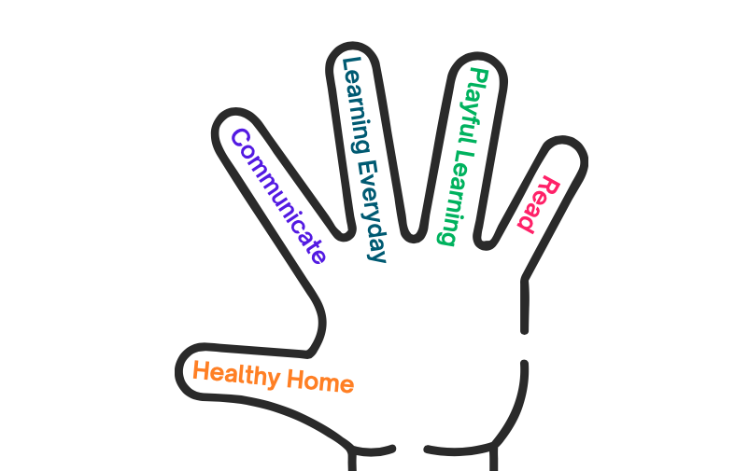
5 ways of growing healthy brains:

Slide 30
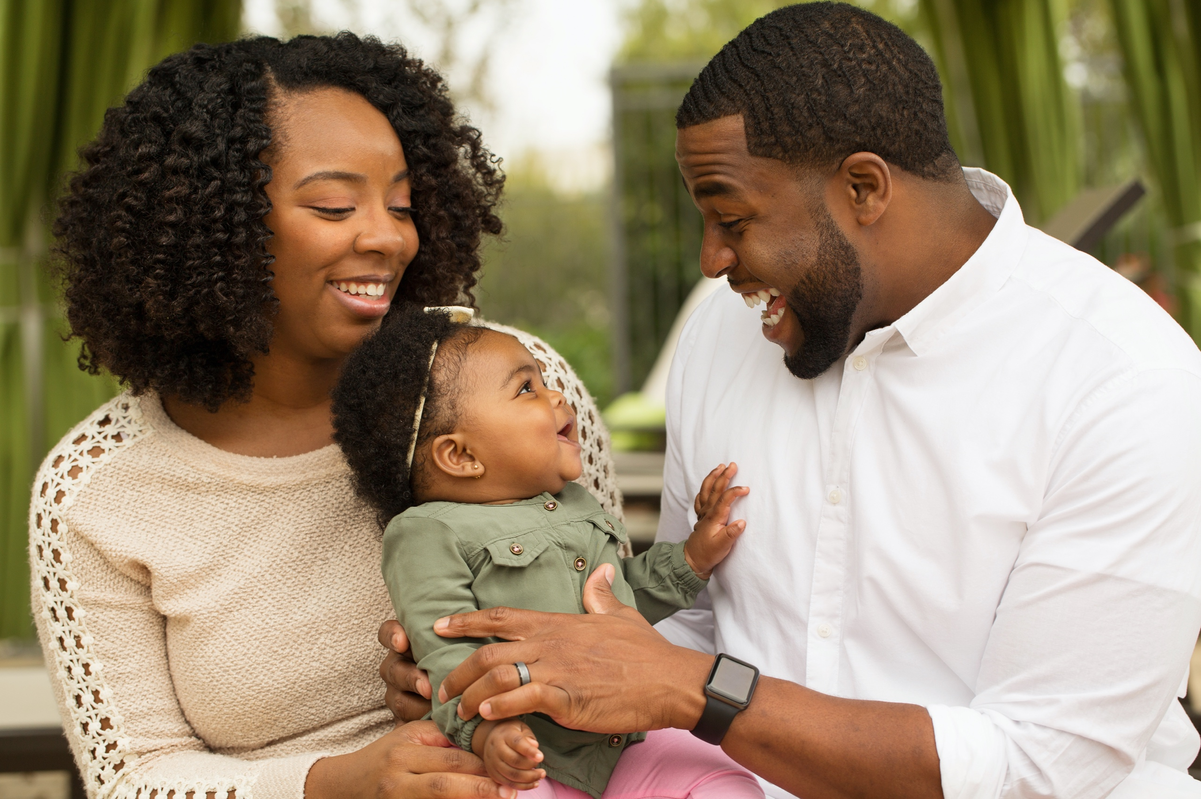
Communicate
Sing
Baby talk – ‘sing song’
Eye contact
Exaggerated expressions
Repeat words
Show interest
Respond to the child’s needs

Slide 31
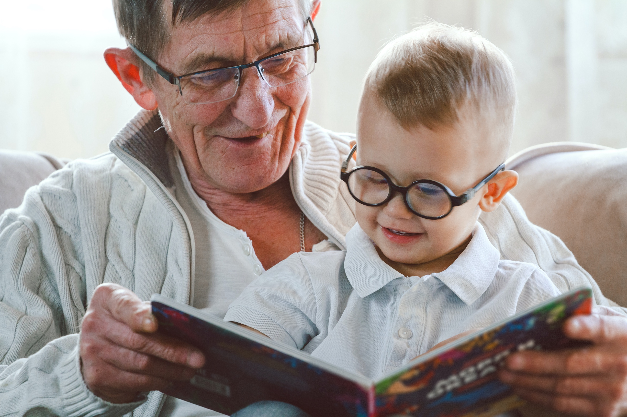
Read
Respond to the child’s interest
Ask questions about the story and characters
Interact with the book and the story
Let the child lead (hold the book and decide pace and direction)
Notes:
Let the child lead – the nature of this will depend on the age of the child.
This is something that the children could practice in school, by reading with reception class – sitting so both can see the book, encouraging the younger child to hold the book. Encourage the older child to notice where the younger child’s attention is, what they point at, look at etc… and respond to that.

Slide 32
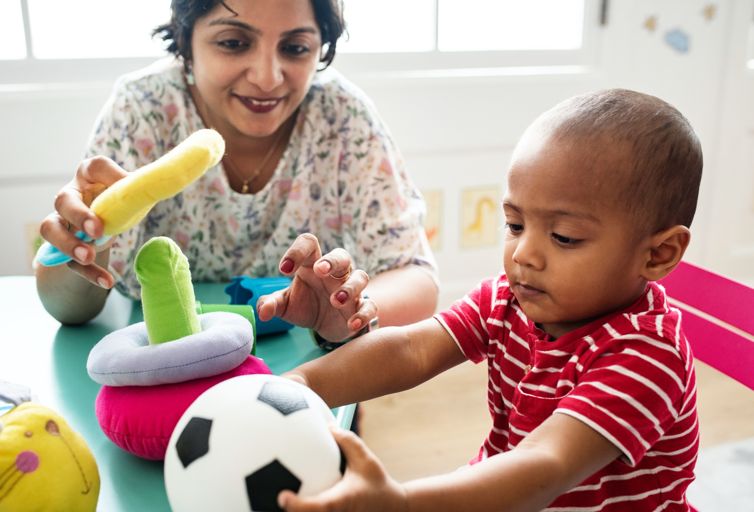
Playful learning
Let the child lead play
Creative play
Imaginary play
Get involved, or
Allow independent play (but show an interest)

Slide 33
Everyday learning
Narrate what you are doing
Label every day items
Count out objects
Teach turn taking
Encourage curiosity
Respond to their needs

Slide 34
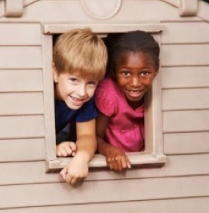
A healthy home
Safe environment
Nutritious diet
Emotional support
Healthy sleep routines
Exploring outdoors
Show you care
Notes:
Different photo?

Slide 35
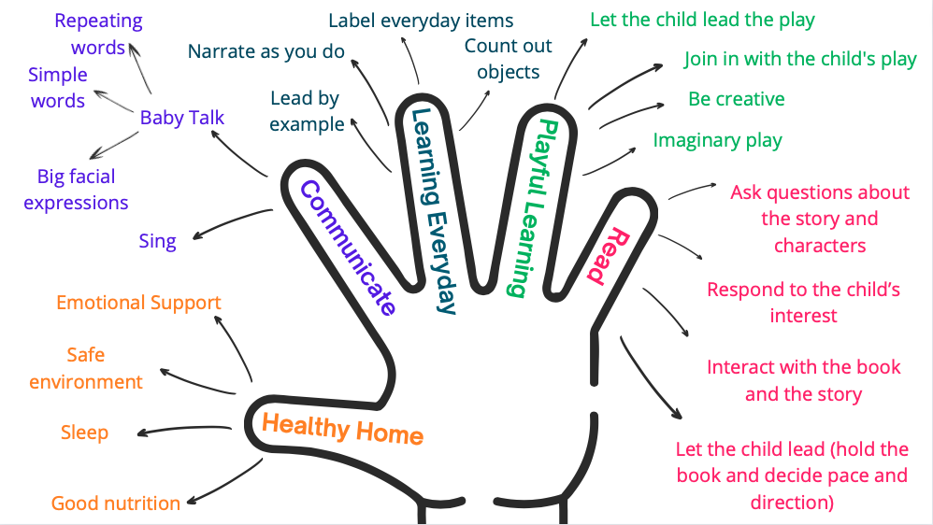
5 ways of growing healthy brains:

Slide 36
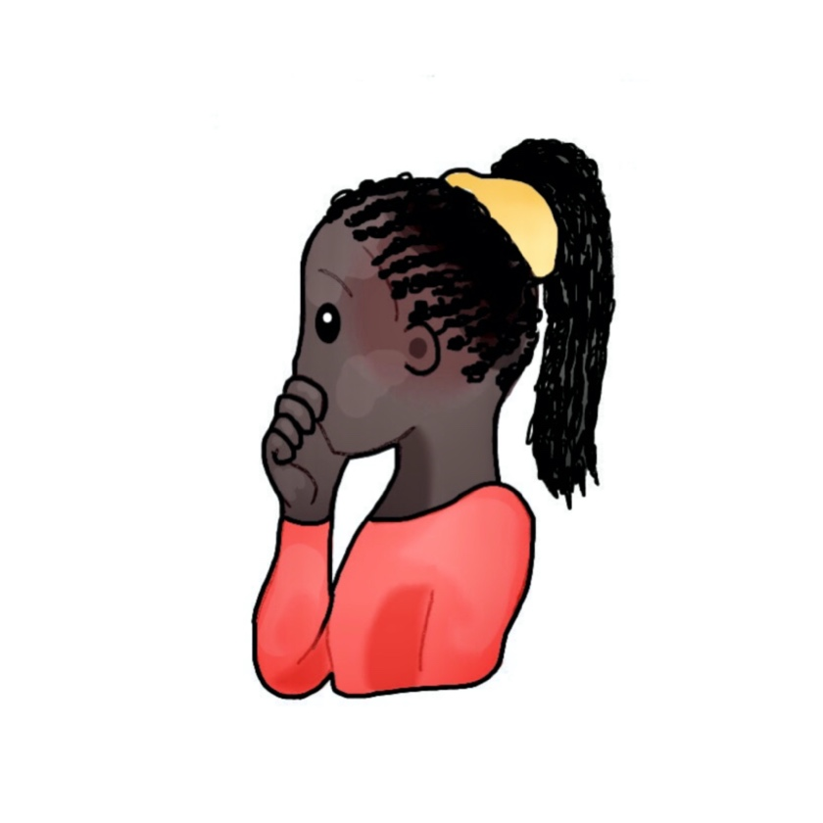
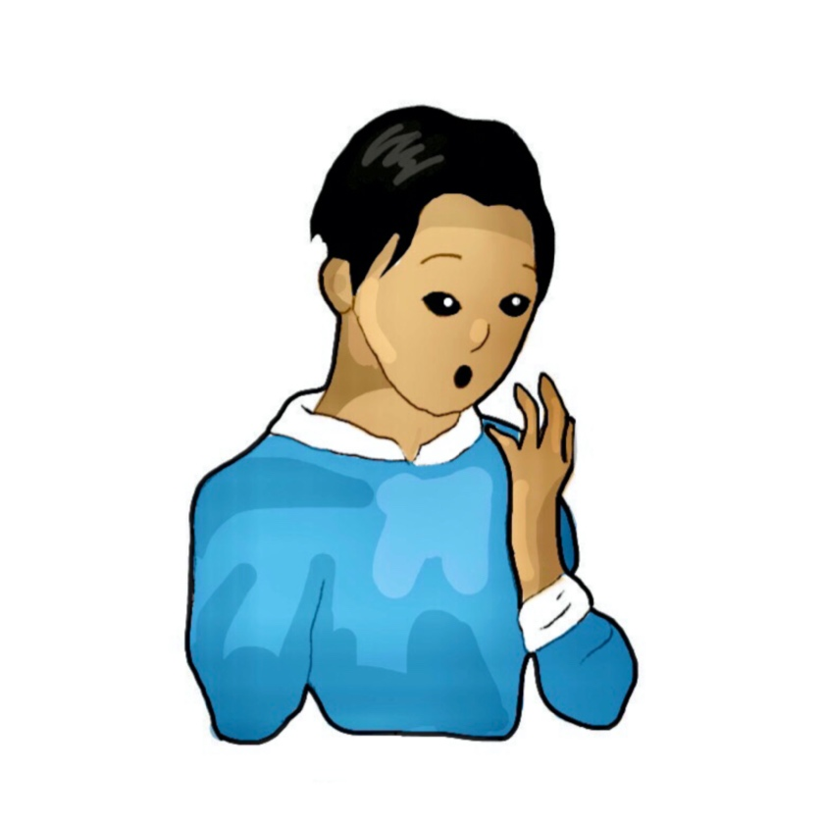
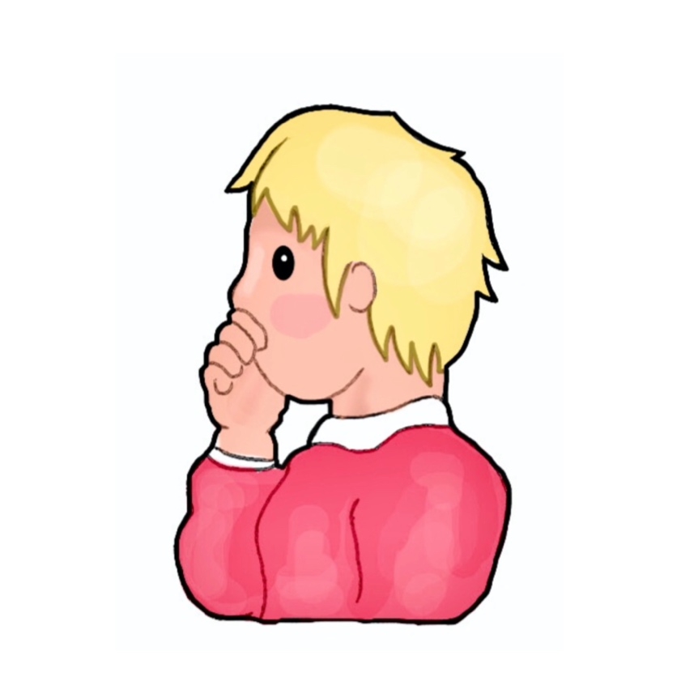
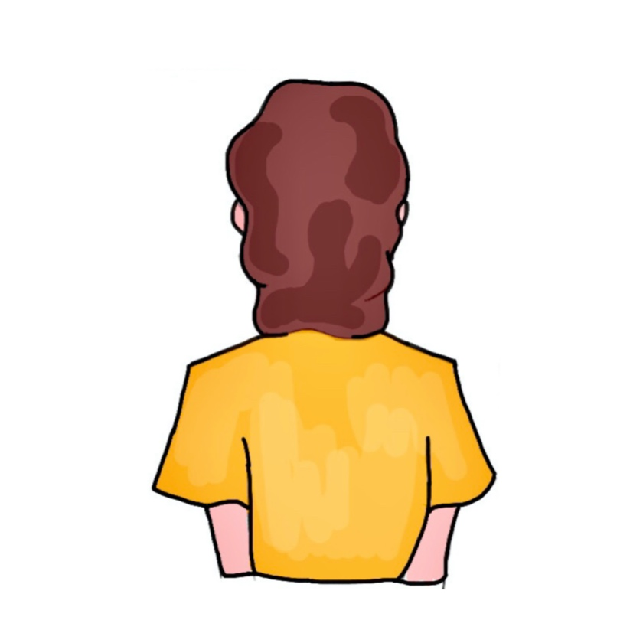
Should we talk to a baby?
Start talking to a baby as soon as they are born. Talk to them normally – that way they will learn how to speak properly.
There’s no benefit in talking to a baby. Not until they can say some words!
Tam
Tyrell
It’s not important in the first few weeks as they cannot speak. When they start making babbling sounds, then it is fun to chat!
I talk to a baby in a sing song voice and exaggerate my face when I speak… it’s like… ‘baby talk’ and really fun!
?
Lilly
Ben
Pat
Notes:
Talking to a baby is incredibly important – see theory below.
It is important to talk to a baby straight away (after birth), it helps ‘fire’ or prime the connections in the brain that form the foundations of language. So Tyrell and Ben are incorrect. Babies, communicate with noise, waving hands, crying etc, well before they can speak.
Tam – Is correct that we should talk to babies from birth It is often a misconception that you should talk ‘normally’ to a baby (in our pilot research we found some teachers were teaching this despite the coverage of baby talk in the lessons). Using baby talk can prime the baby for listening and help develop language networks in the brain.
Lilly is correct as baby talk is important. Combine this with Tam’s idea of communication from birth.
Baby talk is normal language but made simpler, repeating words, higher pitch, speaking slower and with exaggerated facial expressions. Baby talk is instinctive for many people, but not everybody!
https://www.unicef.org/parenting/child-development/baby-talk-class
A baby is primed for social interactions from birth, but for this to happen they need a parent or caregiver, to respond positively to their cues. Sensitive and responsive parent-infant relationships have been shown to be pivotal for the development of infants’ social, emotional, behavioural and cognitive skills. These are the building blocks for child and adult outcomes, with longitudinal research repeatedly demonstrating that these skills are associated with better long term mental and physical health.
The caregiver’s focus of attention to child signals and associated contingent responsiveness (Serve and Return) is essential for the development of the child’s cognitive ability. Contingent responses to the infant also teach the infant about connections between stimuli and responses, and help establish and develop the infant’s own attentional skills.

Slide 37
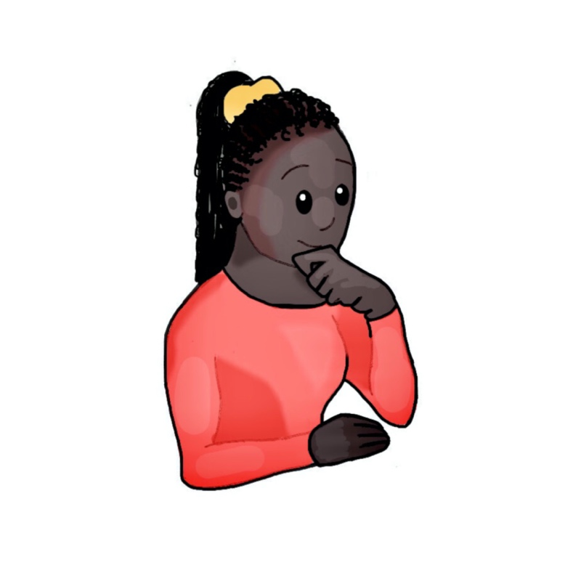
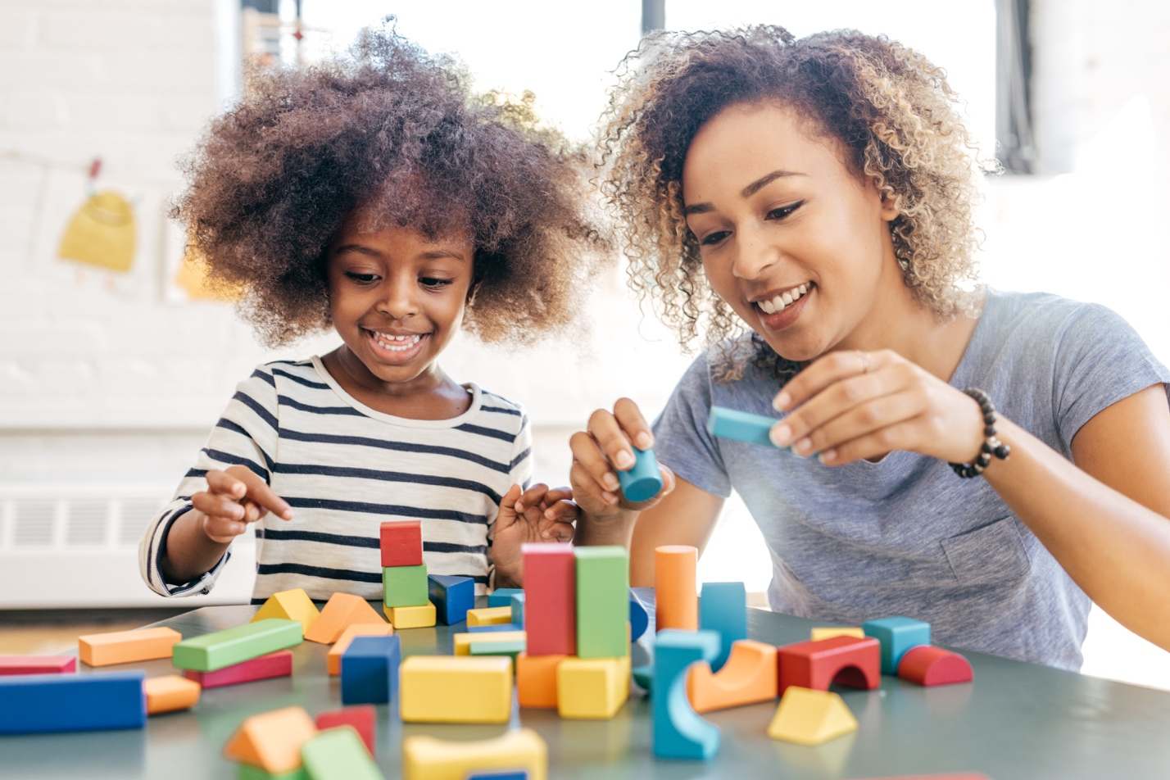
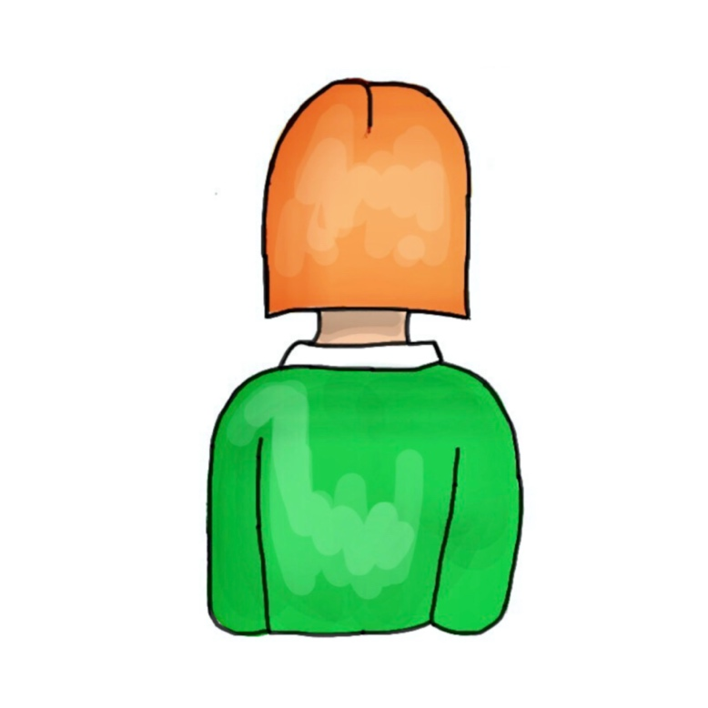
Supporting brain development through playing with building blocks.
I’m going to let you play by yourself. It will help build your creative skills. It gives me time to check my email.
What would you like to make? I’m here if you need me… Wow! What are you building with those red bricks? How about this brick, can you use it?
Evie
Tam
I love bricks! You can play over there with those. I will make a castle here out of these bricks. Let’s see who’s is best!
We will build a tower. I will show you how to do it first then you try. If you can’t do it, I will help you by telling you how.
Teigan
?
Pat
Lilly
Notes:
Ask the students “ how can playing with building blocks best support brain development?” Whose ideas are most correct?
This concept cartoon is more nuanced and there is no clear right or wrong. It therefore gives an opportunity for discussing playful learning and the pros and cons of the different suggestions. Some ideas are given below and in the theory section further down.
Evie – Taylor is modelling excellent playful interactions. They are asking the child what they want to do (child led) rather than directing. The child then makes the decisions, but knows somebody is there to support and is interested in what they are doing. Evie comments and show interest in what the child is doing by asking questions – extending the learning by providing a new brick.
Tam – it is good to allow time for children to play by themselves and explore. It can indeed improve skills. All caregivers have times when they need to do other jobs. In this case Tam wants to check email. This is ok provided it isn’t happening all the time, and there are times that Tam is giving the child their full attention. Either way, by turning her attention to her device, Tam is not being attentive to the child… especially if she is outside of the room.
Teigan – this is often how less experienced caregivers will interact with a young child, by directing the activity, demonstrating, expecting the child to copy and correcting them if they don’t do it the ‘right’ way. There are times when a demonstration followed by trying out themself is helpful. However, this ‘expert’ approach is missing an opportunity for creativity and exploration from the child… after all, there is no ‘right’ way to play with bricks!
Pat – This caregiver is highly competitive and more interested in their own enjoyment with the bricks! This is often a fun and engaging way to play with a child. However, the wording suggests that Jordan is not paying much attention to the needs of the child during this activity – “you can play over there” and the child does not seem to have much choice in how the activity is run.
Theory:
Play is central to learning and brain development, particularly in the early years. It helps to lay the foundations for learning and development by increasing connectivity in neural circuits. Play gives opportunities for: thinking creatively, problem solving, language development, positive social skills, reading and learning to write. The following are ways in which play can support healthy brain development:
Take and make opportunities for playful interactions e.g. peekaboo. Join in.
Play teaches turn taking, focus and concentration.
Follow the child’s idea of how to play and how to use equipment.
Label and describe what is happening as they play. This helps build their vocabulary and language skills. It shows the caregiver is paying attention.
Caregivers can help children increase the complexity of their play interactions or build on what they are doing.
Make believe or pretend play is particularly important for developing some of the executive function skills. Caregivers can improve play experiences by playing along, joining in with the role play by asking questions. They can also look out for social interaction and use of language to interact with other young children and deal with frustration when it arises. The adult can facilitate here by asking questions and encouraging positive interactions. Play complexity should increase as they get older, adding further dimensions to the play. Carers can help support this by suggesting additional depth to the play or questioning to add detail and complexity to the play e.g. “have you thought about doing this… or… what would happen if you did that?”. Caregivers need to also give time for children to play alone too. Promoting play enhances overall child development. It incorporates the principles behind serve and return interactions or contingent responses.

Slide 38
Activity
Use what you have learnt to discuss the caregiver actions on the worksheet.
Which actions will grow healthy brains?
Can you arrange them in a diamond shape to reflect how likely they are to grow a healthy brain?
Notes:
Students can work in pairs or small groups to complete this activity.
Instructions are available on the worksheet.
There is no right or wrong answer to this activity, although some actions could be considered to be more beneficial for brain development than others. See explanation below.

Slide 39
Growing healthy brains
Most likely to grow a healthy brain
Least likely to grow a healthy brain

Slide 40
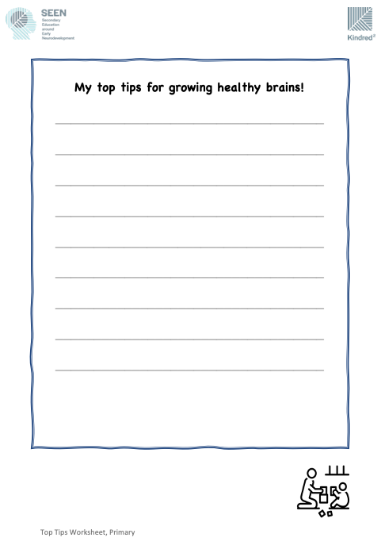
Activity
Discuss the caregiver actions on the worksheet.
Which actions will grow healthy brains?
Pick your 5 top tips for carergivers. Which 5 would you give as advice to somebody caring for a young child?
Extension: explain why you picked these 5.
Notes:
Students can work in pairs or small groups to complete this activity.
They read through the different actions and interactions and decide which they would advise a carer to do.
There is no right or wrong answer here although some actions could be considered to be more beneficial for brain development than others. The activity exposes the children to the many different interactions and actions that a carer does. Each will have an impact on which pathways develop in the brain. Sometimes simple activities can ensure that core skills or language are learnt, or important foundational pathways are laid down.
For the extension, the children might consider any of the following criteria for what makes good advice:
- it is easy to do
- it is likely to make the biggest difference
- they might think people don’t know this
- it is a fun activity.
Possible triggering:
There may be students who are triggered by this activity.

Slide 41
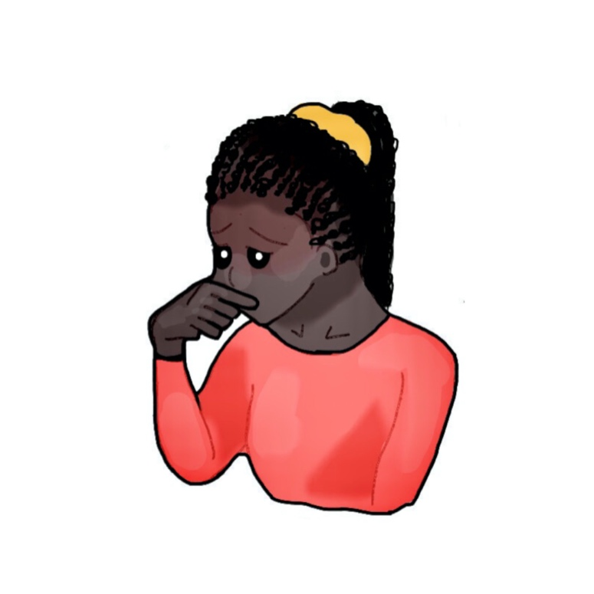
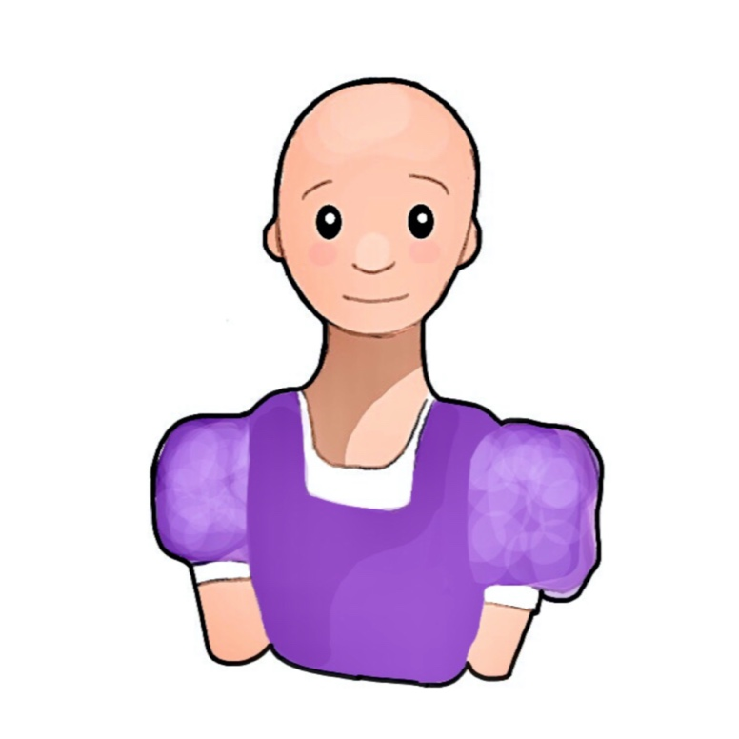
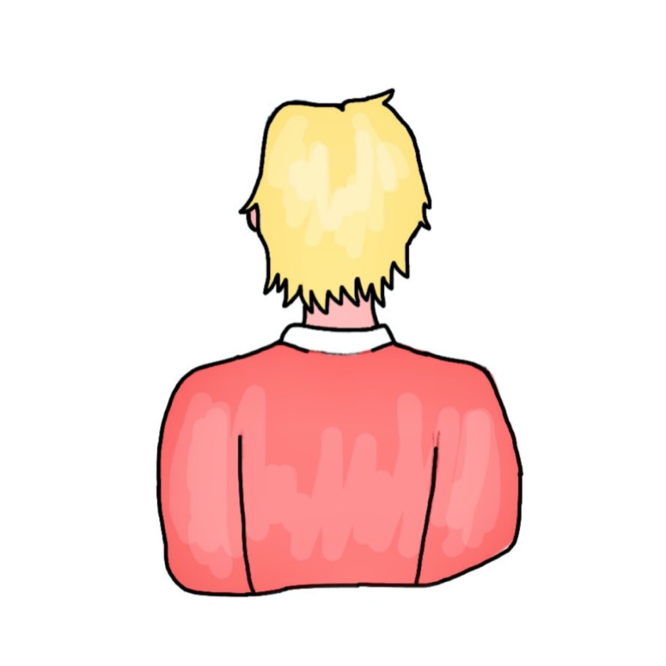
How do you grow a healthy brain during childhood?
Don’t be silly! You can’t ‘grow’ a healthy brain. Our bodies grow depending on the genes we get from our parents. You can’t change that!
It’s important to have strict rules – teach them right from wrong early in life. Then their brain will be healthy for the future.
Tam
I was always told the best thing is to read to a child. Books help language develop and this helps the brain.
Millie
I think it’s a bit of everything… the right food, learning, playing… but it is most important to show that you love and care for them!
Tyrell
?
Ben
Lilly
Notes:
Ask the children to think about how somebody can help grow a health brain in a baby or child.
This concept cartoon is an opportunity to discuss the wide range of ways in which a caregiver can support healthy brain development. It can be used to discuss before or after the lessons – to establish prior understanding and/or determine what has been learnt. If doing before and after the lessons, you could keep the “ideal answers” Students could write down their thoughts before and after the lessons and compare them.
Tam is correct to say that genes have an impact on brain development… but he is wrong overall – the environment or experiences a baby or infant have will affect how the brain grows. Neuroplasticity is the process by which experiences throughout life can change the structure of the brain. The brain can change throughout life.
Millie – children need to know boundaries, particularly when they ensure that a child will be safe and healthy. Children might argue that Millie’s thoughts are correct – teaching right and wrong are important. Whilst teaching right from wrong is critical, there are many other important factors that support healthy brain development.
Tyrell – Tyrell is correct that reading to a child is important and helps strengthen the neural pathways associated with language development in the brain. Reading is one of the most important interventions that can support a child’s early cognitive development. Again, there are other factors though…
Lilly – is correct in that there are a number of factors that work together to support healthy brain development. In the lessons, we cover 5 areas: a healthy and supportive home (love, safety, nutrition); good communication (serve and return interactions, baby talk, etc); everyday opportunities for learning e.g. counting out the laundry, labelling items, narrating what you are doing; reading; and playful learning. Research has shown that one of the most important factors in resilient brain development is the presence of a single caring and supportive adult.
(NB: Millie - You may not want to cover this in class in case of triggering, but you may also find it comes up in discussion - in some extreme cases, super strict environments can become scary or promote fear in a child, if continuous and threatening, it can lead the brain to become more stress sensitive… so this is not necessarily “healthy brain development).

Slide 42
Why is healthy brain growth important?
Notes:
Class discussion.
Ask the children why they think early healthy brain growth is important.
The kind of answers they might give (?!) – please let me know what they do say!:
So children can learn at school.
Help learn important skills
Be able to make friends more easily.
Makes them happier.
Healthier for life.
More intelligent / do better at school.
Scientists know that brain growth in the first few years of life (pregnancy to age 5) is a good predicter of long term mental and physical health, learning, earnings potential and overall wellbeing.
NOTE: it is not deterministic. If a child has a difficult first few years, then these difficulties can be overcome later in life. Remember – the brain is plastic, so can adapt and change with experiences. Positive experiences later in life won’t make early difficult experiences go away, but more and more positive experiences can shift the balance towards the positive.

Slide 43
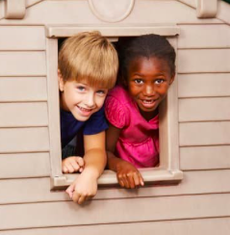
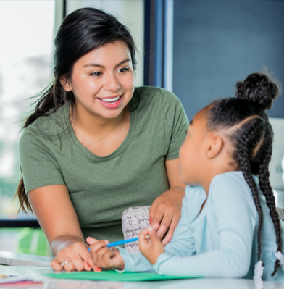
How will you grow healthy brains?
What 5 things will you do differently next time you interact with a 0-5 year old?
Notes:
Plenary activity
Will their learning result in behaviour change?

Slide 44
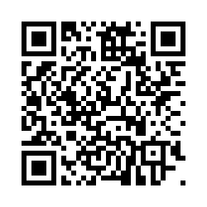
Please complete the post-lesson knowledge check in.
Teachers – please complete the teacher survey by following this link: https://seen.qualtrics.com/jfe/form/SV_8vQ62bYuHmio43c
Notes:
Teacher survey link:
Please do complete the teacher survey, even if you only manage a few of the questions! It let’s us know you finished teaching the sessions and feeds into our national level discussions about a universal education on brain development.
The student post-lesson knowledge check in is optional. However, if you have done the pre-lesson then please also do the post lesson.
It is an online survey. The children will be asked to come up with the same unique code that they used in the pre-lesson survey. They may have it written down.
If you would like a copy of your class results, do let us know on seen@kindredsquared.org.uk
(There is a risk that students spend ages deciding their favourite TV show to help them come up with a code. Encourage them to make a quick decision, ideally different from each other!).
These are the questions they will be asked:
Introduction:
Hi. Welcome back! We hope you enjoyed the lessons. Let’s see what you have learnt.
We are going to ask you a number of questions. Select whichever answers you think are correct. Don't worry, we do not know who is answering the questions. If you don’t know the answer, that’s okay, just choose the 'I don't know' option.
Thank you for taking part!
Student ID:
Do you remember the unique student ID you created in the first survey? You might have written it in your planner.
It’s ok if you can’t remember it, we just need to ask you a few quick questions. It is important to try and remember to use the same answers you used last time.
Q1. What are the initials of your full name?
For example, John James Smith would write JJS. Arjun Patel would write AP.
Q2. What are the first 3 letters of your favourite TV show/series?
If the title begins with 'The', please use the next word.
For example, The Simpsons, you would write 'Sim' and Doctor Who, would be 'Doc'.
Q.3 What is your house number or name?
For example, if you live at 10 Downing Street, you would write 10.
Or if you live at Holly House, you would write Holly House.
If you have moved house since doing the first quiz, please use the house number or name of where you used to live.
Your Student ID is: XXX
Demographic Questions:
Q1. What school do you go to?
Q2. What year group are you in?
Year 3
Year 4
Year 5
Year 6
Multiple Choice Questions
1) What is the role of the brain? (Tick any that are correct)
a) to form and store memories
b) to control the movement of your legs
c) to control breathing
d) to help you think and learn
e) I don’t know
2) What is the brain made of? (Choose one answer)
a) muscle cells
b) neurons
c) bone
d) jelly
e) I don’t know
3) Which of the following best describes brain development (or growth) in the first 5 years of life? (Tick any that are correct)
a) the brain grows very fast
b) the brain’s structure is determined by the experiences a child has.
c) the brain is fully grown at birth
d) a child’s caregiver plays an important role in brain growth
e) I don’t know
4) Which of the following will help a baby’s brain grow healthily? (Tick any that apply)
a) eating nutritious food
b) a parent or carer reading a book
c) a carer singing to the baby
d) growing up in a safe and caring home
e) playing peekaboo
f) I don’t know
5) Which of the following best describes why early brain development (or growth) is important? (Tick any that apply)
a) it helps a child learn and do better at school
b) it forms a strong base for lifelong health and wellbeing
c) it doesn’t matter – the brain grows throughout life
d) because this is when all memories form
e) I don’t know
Post-lesson evaluation questions
We would like to know your opinion and thoughts about the lessons.
Q1. How would you rate the lesson?
5 star rating system
Q2. Tell us one thing you think needs improving about the lessons.
Q3. How much did you enjoy the lessons?
Rate using an emoji face – sad to happy
Q4. Tell us one thing about the lessons that you liked.
Q5. How much did you learn? 10 - you learnt lots, 0 - you didn't learn anything.
Move a bar to change the number displayed.
Q6. Tell us one thing you learnt.
Q7. Tell us one thing you would like to know more about.
Q8. Do you think young people your age should be taught about the brain and early child development?
a) Yes
b) No
Q9. Please explain your answer.
Q10. Following these lessons, will you interact differently with babies and young children?
a) Yes
b) No
If Yes is selected:
Q11. Tell us one thing you will do differently now when you interact with a baby or young child.
Thank you, you have now completed this quiz!
We hope you enjoyed taking part in these lessons.

